Slide 1

SRI AUROBINDO INSTITUTE OF PHARMACY
TOPIC:-ANTI TUBERCULER ANTI DRUG
SUBMITTED TO:
MR.AKHILESH BILAIYA SIR
SUBMITTED BY :
AMAN SHUKLA

Slide 2
OBJECTIVE
Understand the chemistry of Drugs.
Know the importance of SAR of drugs.
3. Know the Adverse effect and therapeutic value of drugs
Learning outcomes
Student will learn about the Chemical structure and Medicinal uses of drugs.
Student will learn about the Relation of drug and its Activity.

Slide 3
INTRODUCTION
• Ant Tubercular:- These are Those drug which basically used in the treatment of tuberculosis .
.Tuberculosis:-
It is on infectious Disease usual caused by mycobecterium tuberculosis bacteria.
.This bacteria usually attack the lungs but they can also damage other Part of body such as brain kidney etc.
.Tuberculosis spreads through the air when a person with active TB infection cough Sneezes, spit or talk.
.Symptoms:-
chronic cough with blood containg ,mucous ,fever nightsweats weightloss .

Slide 4
Tuberculosis :-most important communicable diseases in the world.
• Mycobacteria are intrinsically resistant to most
antibiotics
– Grows more slowly than other bacteria – antibiotics
active against rapidly growing cells
– lipid-rich mycobacterial cell wall is impermeable to
many agents
– It grows inside macrophage – poorly penetrated by
drugs
– Excellent ability to develop resistance – Multiple Drug
Resistant (MDR)

Slide 5
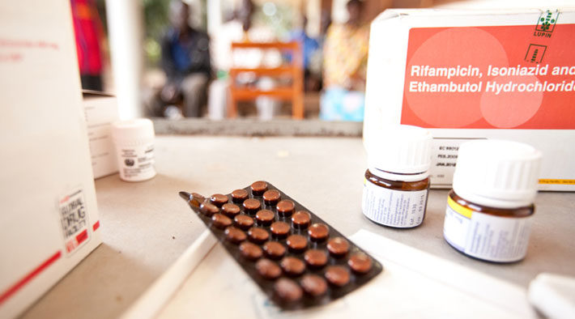
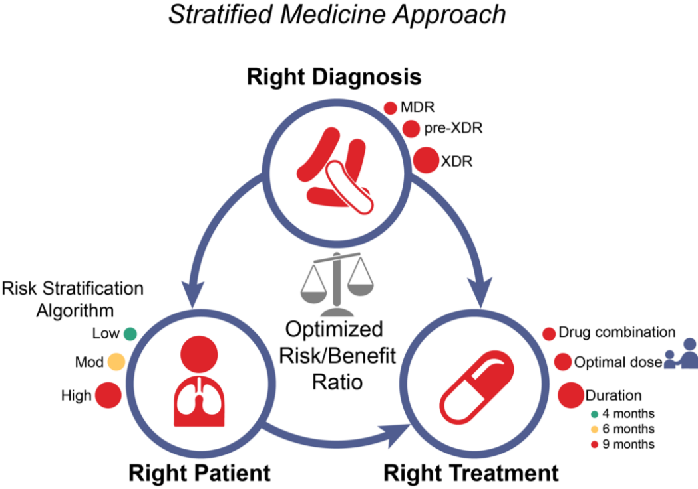
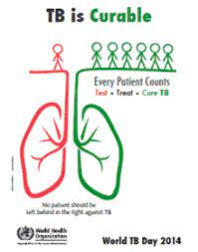
Antitubercular Drug

Slide 6
Classification
According to clinical utility the anti TB drugs can be divided into 2 groups
First Line : high antitubercular efficacy as well as low toxicity – routinely used
Isoniazid (H) , Rifampin (R), Pyrazinamide (Z),
Ethambutol (E), Streptomycin (S) - HRZES
Second Line : low antitubercular efficacy or high toxicity
Paraminosalicylic Acid, Cycloserine, Kanamycin, Amikacin, Ciprofloxacin, Olfloxacin, Clarithromycin, Azithromycin

Slide 7
First Line Drug/ SECOND LINE DRUG

Slide 8
RIFAMPIN
Semisynthetic derivative of rifamycin -produced by Streptomyces mediterranei
Active in vitro against gram-positive and gram- negative cocci, some enteric bacteria, mycobacteria, and chlamydiae.
Resistant mutants - approximately 1 in 10⁶ organisms
Rapidly selected out if rifampin is used as a single drug – must be used in combination
no cross-resistance to other classes of antimicrobial drugs

Slide 9
Mechanism of Action & Resistance
Binds to the bacterial DNA-dependent RNA polymerase - inhibits RNA synthesis
Bactericidal for mycobacteria
Readily penetrates most tissues and penetrates into phagocytic cells
Can kill organisms that are poorly accessible to many other drugs
Intracellular organisms
sequestered in abscesses and lung cavities
Resistance: mutations result in reduced binding of rifampin to RNA polymerase

Slide 10
Clinical Uses
10 mg/kg/d O.D. for 6 months in combination with isoniazid or other antituberculous drugs to patient.
Some atypical mycobacterial infections and in
leprosy
600 mg twice daily for 2 days can eliminate
meningococcal carriage
20 mg/kg/d for 4 days - prophylaxis in contacts of children with Haemophilus influenzae type b disease
Serious staphylococcal infections - osteomyelitis and prosthetic valve endocarditis

Slide 11
Streptomycin
Part of aminoglycosides antibiotic
First clinically useful antitubercular drug, but less effective than INH or rifampin
Acts only on extracellular bacilli – poor penetration into cells
Doesn’t cross the BBB, but penetrates tubercular cavities

Slide 12
Mechanism of action
Irreversible inhibitors of protein synthesis,
Bactericidal
Inside the cell, aminoglycosides bind to specific 30S-subunit ribosomal proteins and inhibits protein synthesis
Resistance
Inactivation by adenylylation, acetylation, or phosphorylation
impaired entry into the cell
receptor protein on the 30S ribosomal subunit - deleted or altered as a result of a mutation

Slide 13
Clinical Use
Treatment of infections resistant to other drugs
Adults: 20–40 mg/kg/d daily for several weeks
– Followed by 1–1.5 g two or three times weekly for several months
Other drugs are always given in combination to prevent emergence of resistance
Nontuberculosis species of mycobacteria other than Mycobacterium avium complex (MAC) and Mycobacterium kansasii are resistant
Dose is reduced to half in hemodialysis patient

Slide 14
Capreomycin
peptide protein synthesis inhibitor antibiotic obtained from Streptomyces capreolus
Daily injection of 15 mg/kg/d intramuscularly
treatment of drug-resistant tuberculosis
Strains of M tuberculosis that are resistant to streptomycin or amikacin - susceptible to capreomycin.
Nephrotoxic and ototoxic - Tinnitus, deafness, and vestibular disturbances occur
local pain, and sterile abscesses may occur

Slide 15
Cycloserine
inhibitor of cell wall synthesis
0.5–1 g/d in two divided oral doses
Cleared renally - Dose is reduced to half in case of renal dysfunction
peripheral neuropathy and central nervous system dysfunction, including depression and psychotic reactions.
Pyridoxine, 150 mg/d given in addition to it

Slide 16
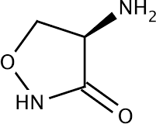
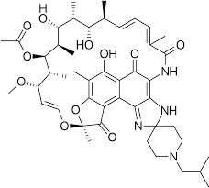
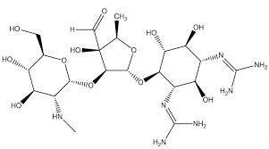
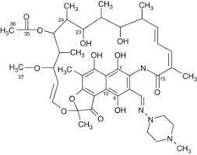
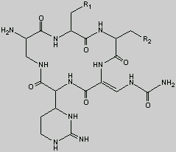
Structures
Rifabutin
Cycloserine
Streptomycin
Rifampicin
Capreomycin

Slide 17
References
Basic & Clinical Pharmacology Bertram G. Katzung Twelfth Edition
Essential of medical pharmacology - K.D. Tripathi 6th edition
Lippincott - Modern Pharmacology With Clinical Applications 6E
Color Atlas Of Pharmacology, 2Nd Ed (Lüllmann, Thieme 2000)

Slide 18

